Slide 1
Welcome Students
5th Grade Computers
Mrs. Borger

Slide 2
Exploring Technology
Hardware
Internet use/Digital Tools
Word Processing
Desktop Publishing
Spreadsheets
Presentations
Google Earth
Image Editing
Digital Citizenship

Slide 3
Project Examples
Google Earth Tour
Outlining in Word
Searching the Internet
Evaluating a website
Making a newsletter
Making a calendar
Graphics in Office
Image Editing
Using formulas
Inserting Charts and Graphs
Making a tri-fold

Slide 4
Our Classroom
Enter Quietly
Clean Hands
Help your neighbor with words, not your hands
Save early, save often – about every ten minutes.
No food or drink
Listen when others are talking
Respect the work of others and yourself
Wait to be called on to speak
Push your chair in
Leave Quietly

Slide 5
Assignments
Assignments will be completed in class.
If you miss a class or do not finish
Submit via email: cborger@ndbeth.org
Submit next class

Slide 6
Problem Solving?
Computer/Monitor does not work?
Check power
Volume does not work?
Check control
Double-click does not work?
Try enter
Lost your program
Check Taskbar

Slide 7
Save or Save As?
SAVE
SAVE AS
Save the first time
Resave changes to the same location
Resave under a new name
Now you have two different files
Resave to a new location

Slide 8
Two Ways to Delete
Backspace
Delete

Slide 9
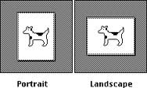
Portrait vs Landscape
Landscape
Portrait

Slide 10
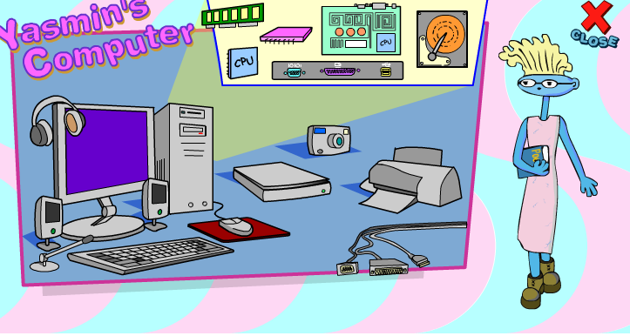
Mouse, CPU, Monitor, System Unit, Ports, Keyboard
http://www.growing.course.com/level_5/parts/index.html

Slide 11
Search for images
Open Word, Choose 4 Items, Search for an image.
Paste each picture in a Word file.
Save the file as Your Name_Hardware in the appropriate 5th Grade Folder (Computers then 5A or 5B).
System Unit
CPU (Processor)
RAM
ROM
Cache Memory
Sound Card
Power Supply
Motherboard
Hard Drive
Optical Drive

Slide 12
Try This
http://www.quia.com/rr/472752.html
How did you do?

